Slide 1
Measures of prediction accuracies of classifiers
Srikanth Gunturu
Guest Faculty
BITS, WILP

Slide 2
In this segment
Measures of prediction accuracies of classifiers
Metrics
Precision
Recall
F1
ROC Curve – AUC of ROC
Generating ROC Curve

Slide 3
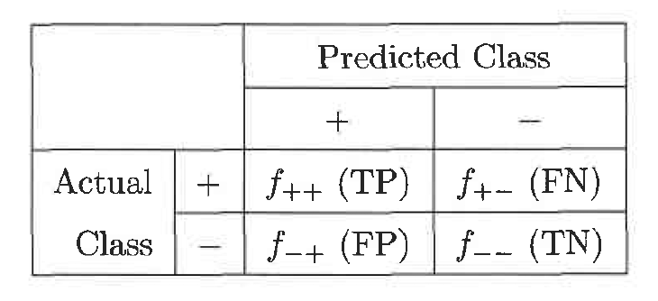
Measures of prediction accuracies of classifiers
Metrics - Basics
True positive (TP) / f++ : number of positive examples correctly predicted by the classification model
False negative (FN) / f+- : number of positive examples wrongly predicted as negative by the classification model
False positive (FP) / f-+ : number of negative examples wrongly predicted as positive by the classification model
True negative (TN) / f-- : number of negative examples correctly predicted by the classification model
Confusion Matrix can be represented as:

Slide 4
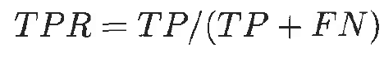
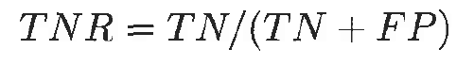
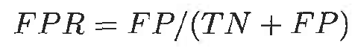
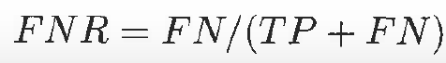
Measures of prediction accuracies of classifiers
Metrics - Basics
True positive rate (TPR) or sensitivity is defined as the fraction of positive examples predicted correctly by the model
True negative rate (TNR) or specificity is defined as the fraction of negative examples predicted correctly by the model
False positive rate (FPR) is the fraction of negative examples predicted as a positive class
False negative rate (F N R) is the fraction of positive examples predicted as a negative class

Slide 5
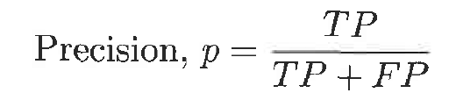
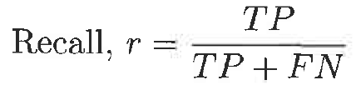
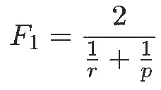
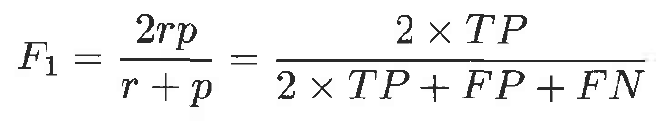
Measures of prediction accuracies of classifiers
Precision, Recall & F1
Precision determines the fraction of records that actually turns out to be positive in the group the classifier has declared as a positive class
The higher the precision is, the lower the number of false positive errors committed by the classifier
Recall (same as TPR) measures the fraction of positive examples correctly predicted by the classifier
Classifiers with large recall have very few positive examples misclassified as the negative class
Harmonic between precision & recall is known as F₁ measure
High value of F₁ measure ensures that both precision and recall are high

Slide 6
Measures of prediction accuracies of classifiers
Receiver Operating Characteristic (ROC) Curve
ROC curve plots TPR and FPR, to graphically represent their trade-off
Area Under Curve (AUC) of ROC – evaluates model performance on average
AUC of ROC = 1, for a perfect model
AUC of ROC = 0.5, if the model is random
For model comparison, AUC of ROC should be larger for the model to be superior or better performing

Slide 7
Thank You!
In our next session:
Finding optimal k for kNN classifiers

Slide 8
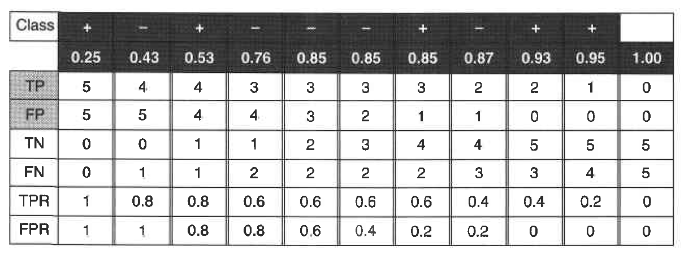
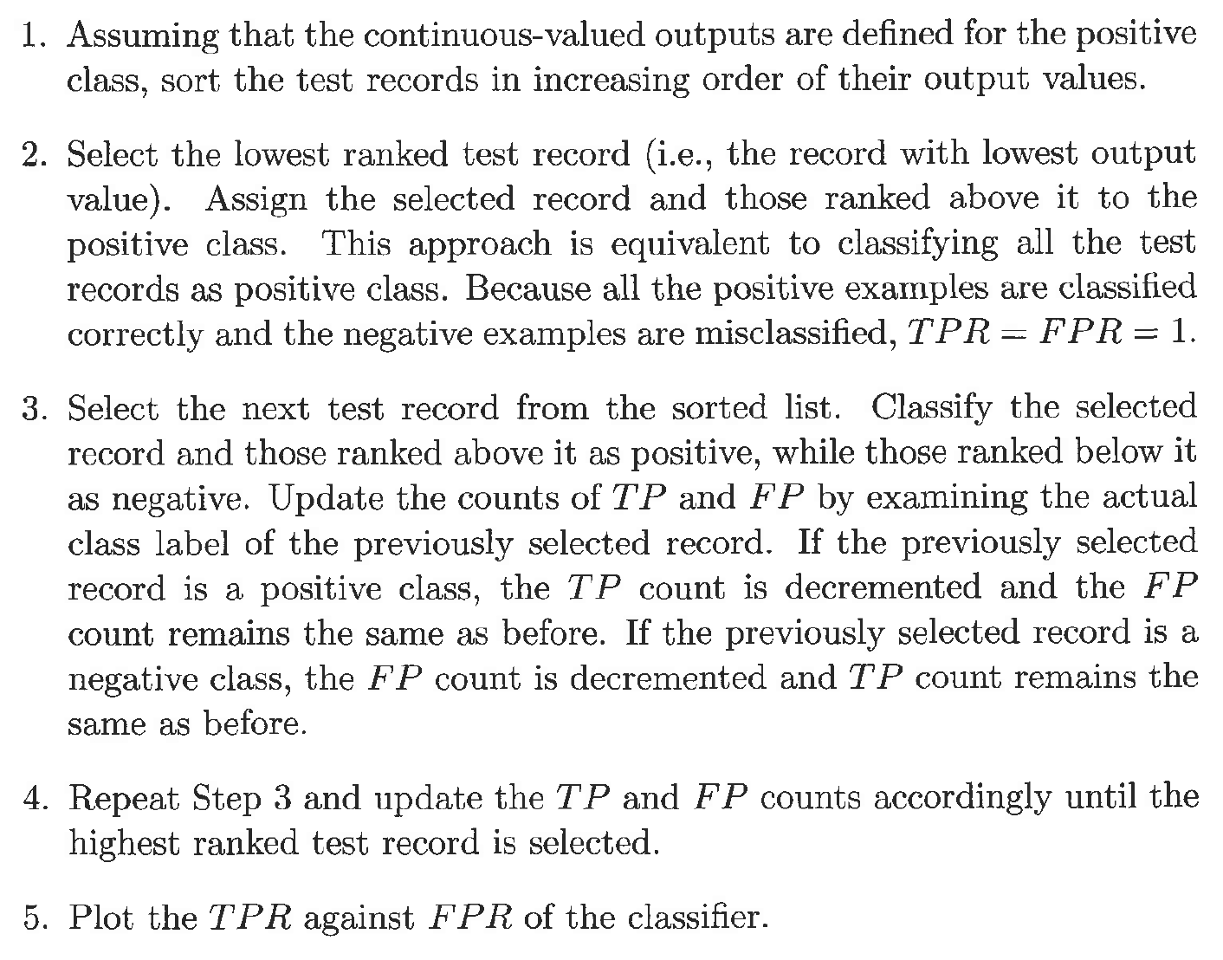
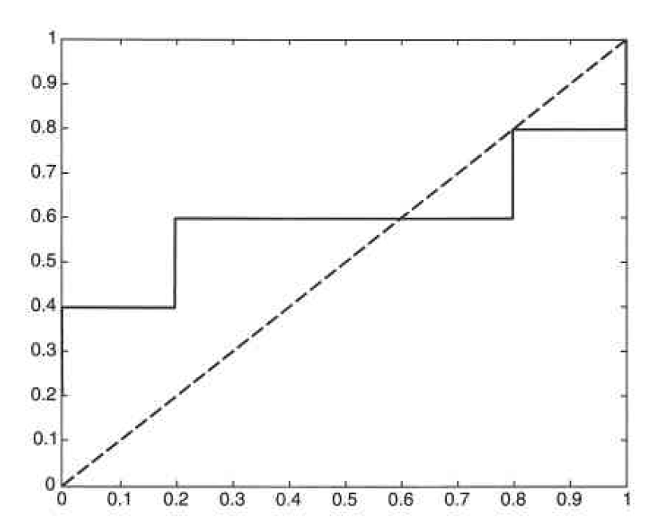
Measures of prediction accuracies of classifiers
Generating ROC Curve – with example

